Slide 1
P/T Experiment Classical Simulation
By Jason Guo, advised by Professor Filippone
Code located at https://github.com/erfz/pt-experiment

Slide 2
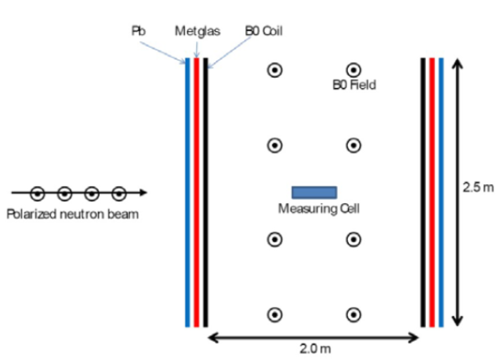
Goal: obtain classical polarization predictions for P/T experiment to compare against empirical results
y
Quantum averages should (hopefully) match up with classical prediction
Must be able to evolve through very different materials (Pb superconductor is simple compared to Metglas)
Default geometry used by simulation shown to the right (easily respecified)
x
z

Slide 3
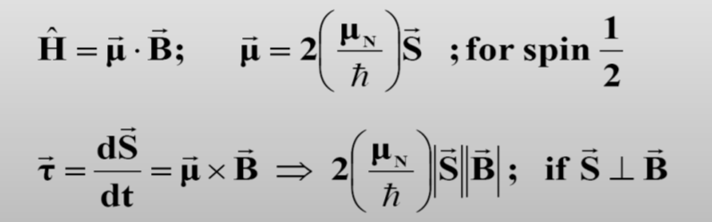
Classical Model using Bloch Equation
Currently evolved using SciPy’s solve_ivp (using LSODA method)
Relative and absolute tolerances of 1e-8 seem to work well
Runge-Kutta (RK45 and DOP853) work as well, albeit slower

Slide 4
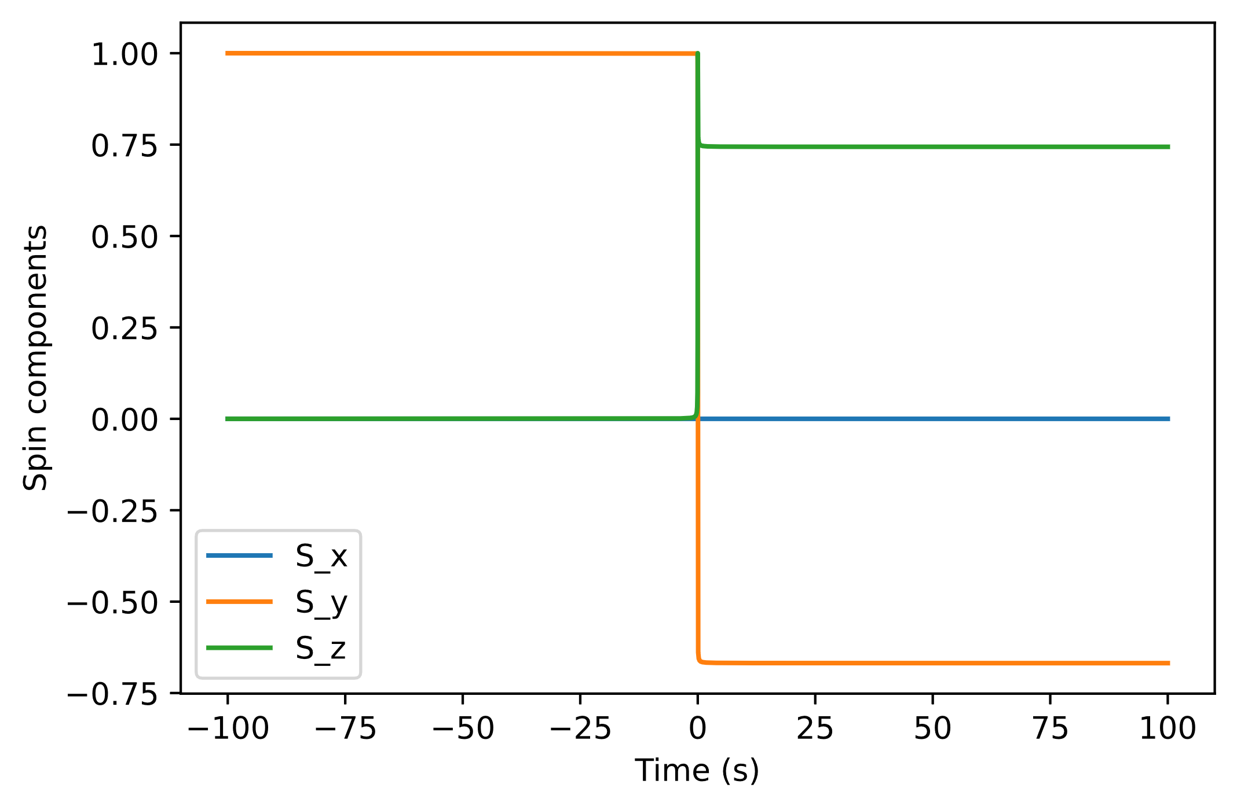
Simulation of particle passing by two wires
Final spin: [0.0, -0.6682047135397682, 0.7439771503034246]
Speed: 1000 m/s
Wire separation: 10 m
Top wire: 10 A
Bottom wire: -10 A

Slide 5
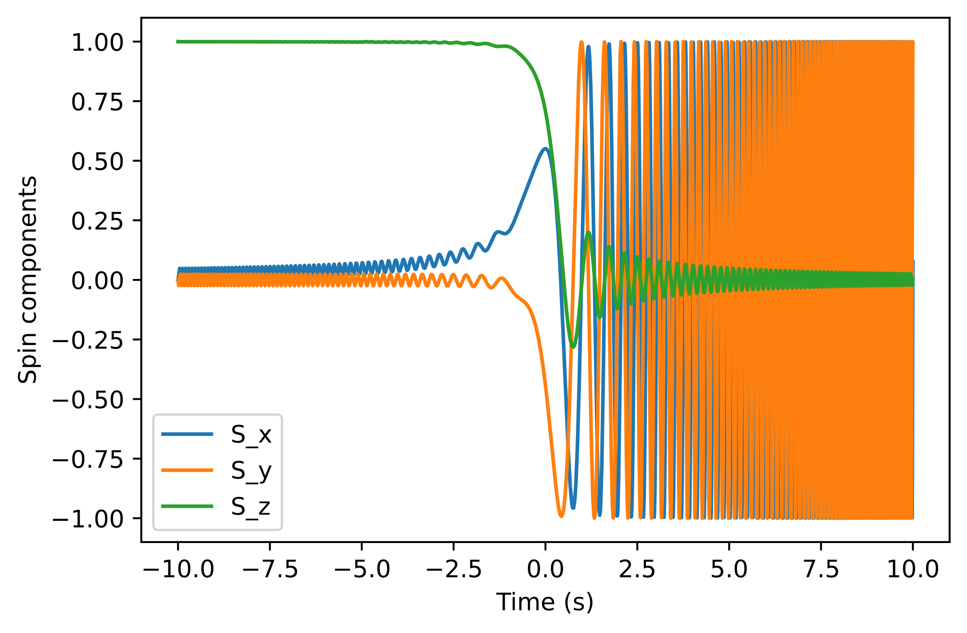
Simulation of particle evolving under Vladimirskii field
Field = [Hx, 0, t * H_dot] with Hx = 10 nT, H_dot = -41.5 nT/s
Final spin: [0.07625445246664814, 0.9970861336744352, 0.003762795417459164]
Corresponding realignment probability: 50.18813977087295%
Theoretical realignment probability: 49.97872272254392%

Slide 6
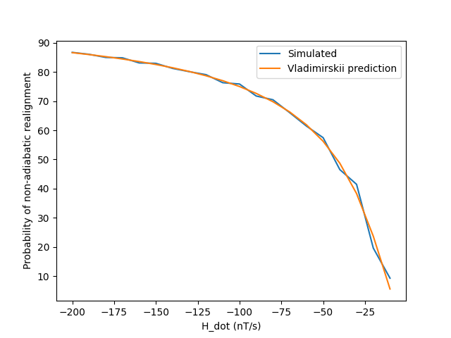
Hx = 10 nT
Simulation time at each point: 20 seconds

Slide 7
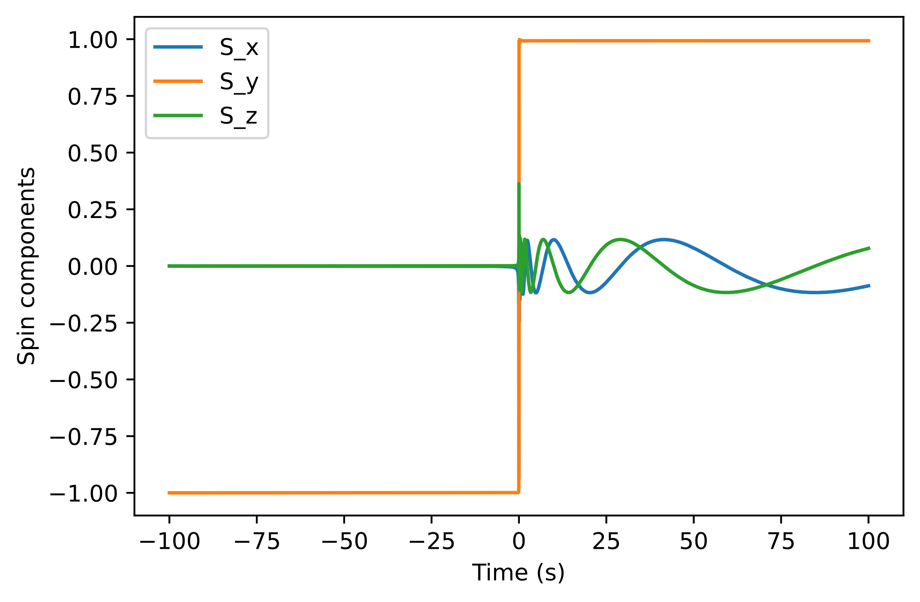
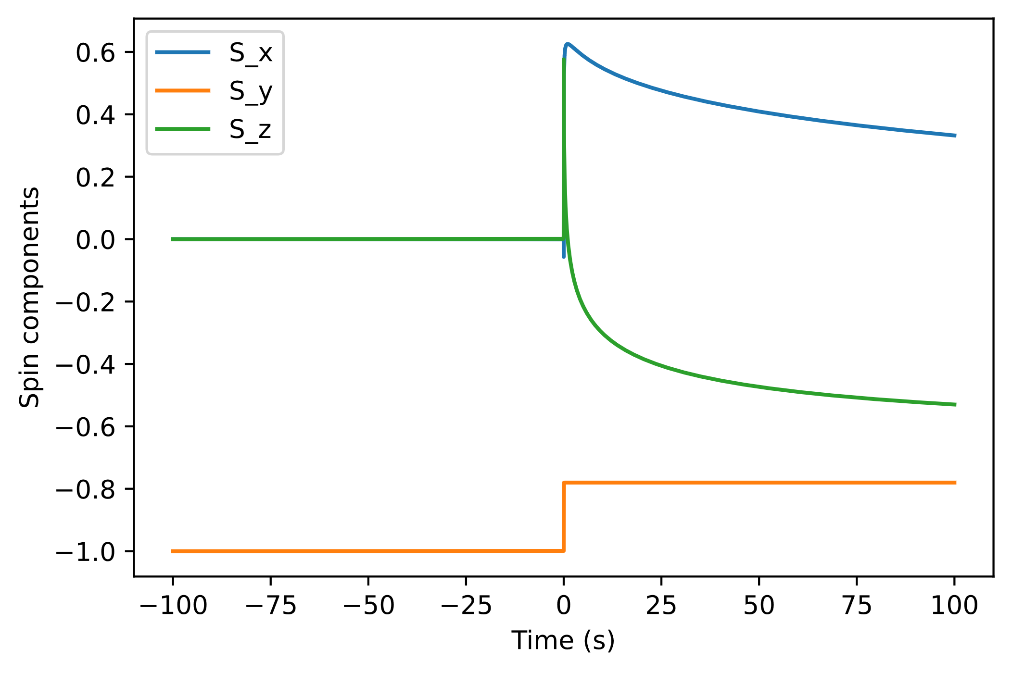
Differing particle speed while passing by two wires
Position: traveling along y = 4.5 cm
Wire separation: 5 cm (one at y = 2.5 cm, the other at y = -2.5 cm)
Top wire: 0.3 A
Bottom wire: 0.3 A
Speed = 5 m/s
Final spin: [-0.08735400424031332, 0.9931222835729916, 0.07795298299791759]
Speed = 100 m/s
Final spin: [0.33223344714498293, -0.7801738237958111, -0.5300469683788319]

Slide 8
Challenges with Metglas
Much, much stronger field (0.5 T) compared to other components of the experiment (which are on the order of microtesla)
Strong field coupled with neutron magnetic moment results in many, many oscillations inside the material
Very thin material (0.1 mm)
Must adjust the solver accordingly (very small time steps, small tolerances) in order to properly evolve the system (maintain normalization and “see” every domain)
Difficult to model exactly – domains can have varying sizes and random magnetic field orientations depending on the saturation

Slide 9
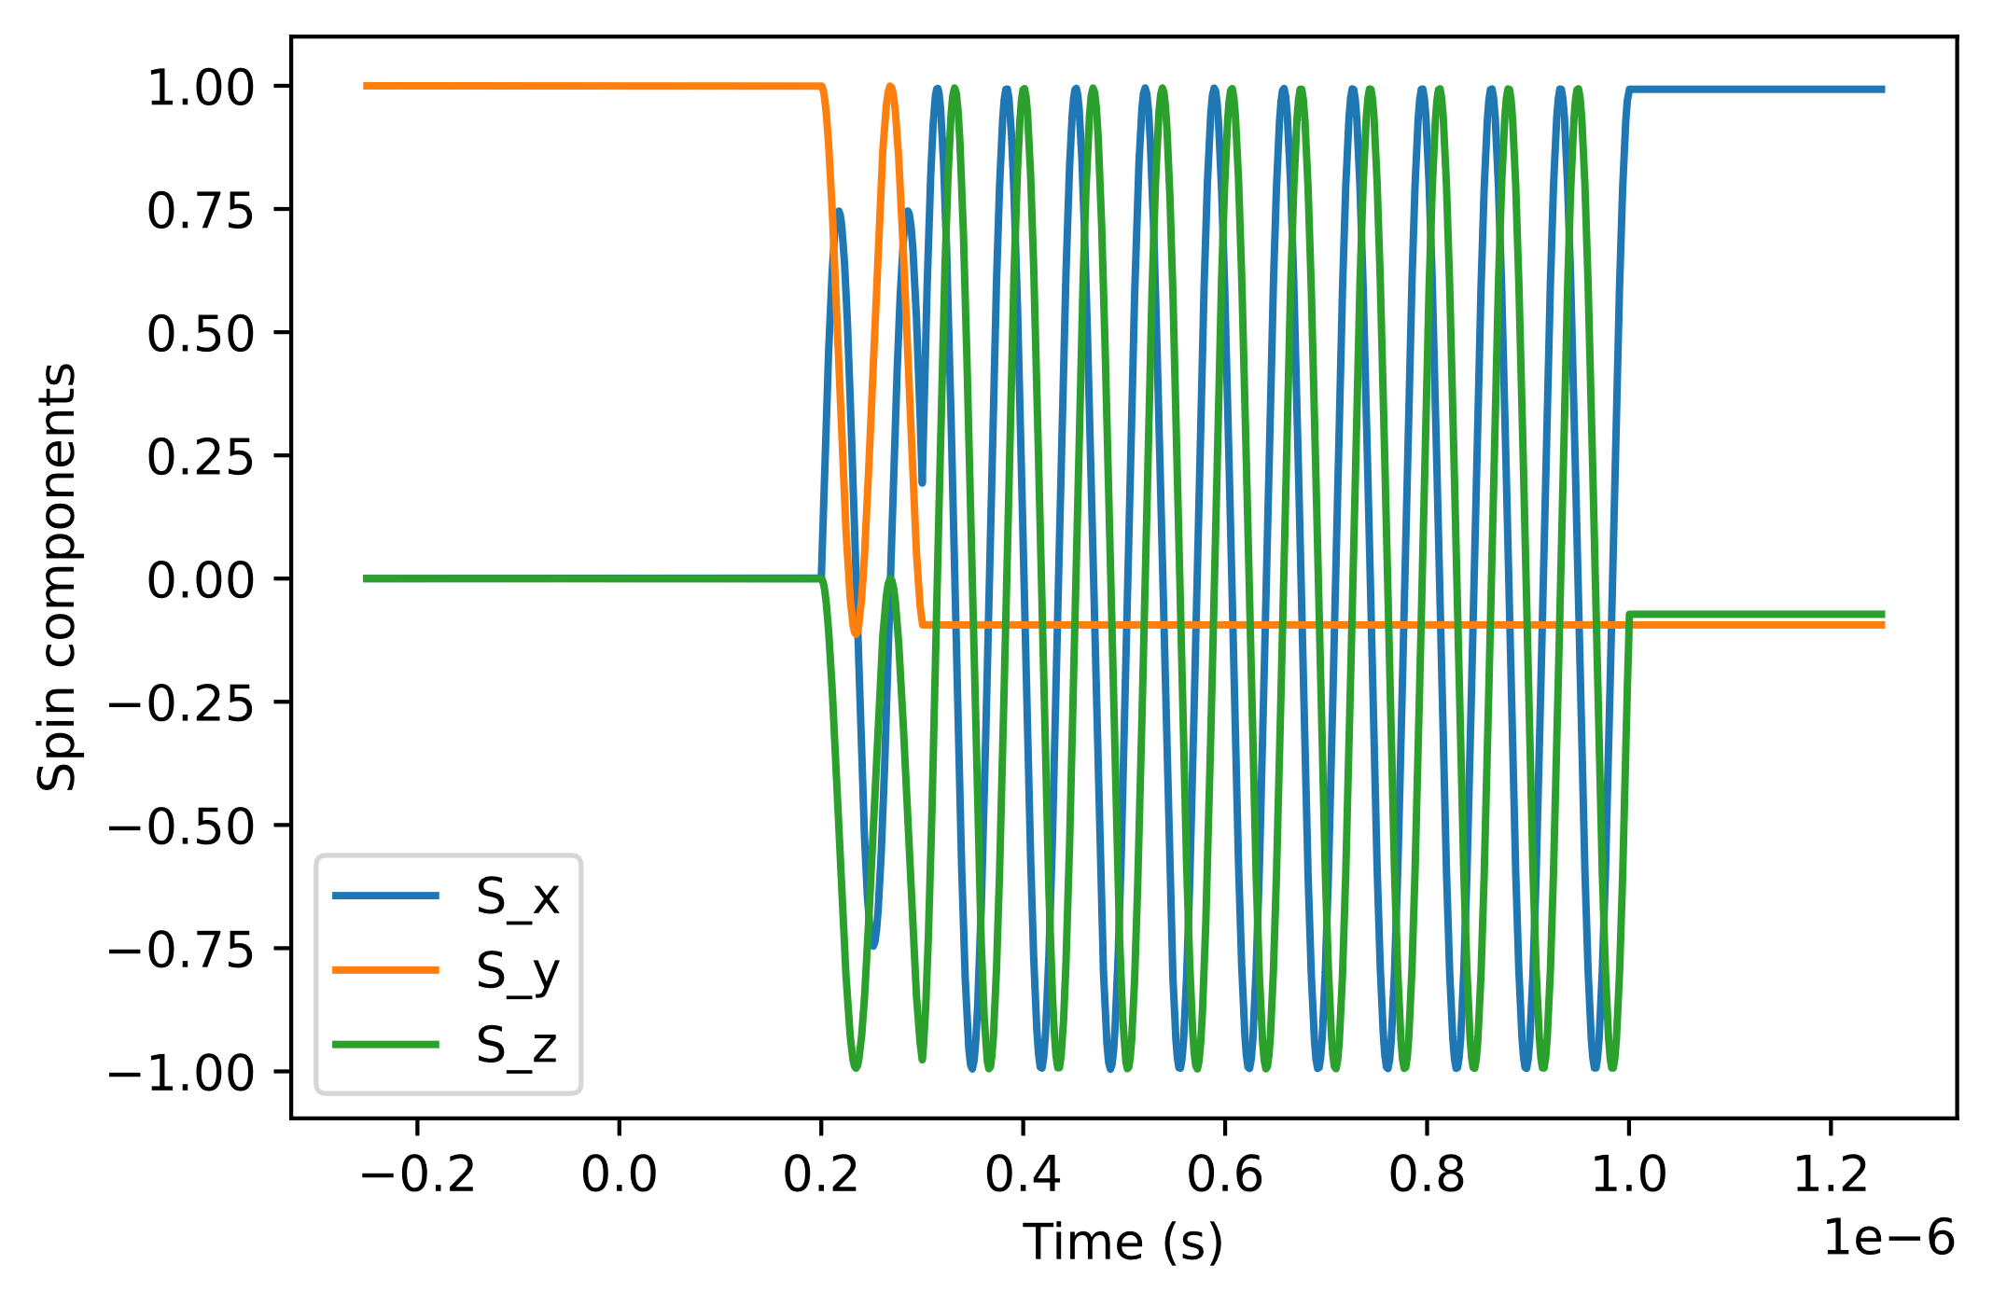
Oscillations within Metglas
Final spin: [0.9929377240255438, -0.09402723622844013, -0.072357613056144]
Metglas domain field strength: 0.5 T
Domain dimensions: 10 μm x 10 μm
Speed: 100 m/s
Saturation: 0.82
Metglas length: 0.1 mm
Metglas width: 0.1 m

Slide 10
Next Steps
Obtain sensible plots that show the relationships between:
Average polarization vs saturation
Average polarization vs domain dimensions
Average polarization vs particle speed
Fully randomize magnetic field of unsaturated Metglas domains
Find more information on Metglas domain geometry and/or tune domain dimensions to match closely with experimental material data
Allow for cylindrical geometry of materials (currently all materials are rectangular prisms)

Slide 11
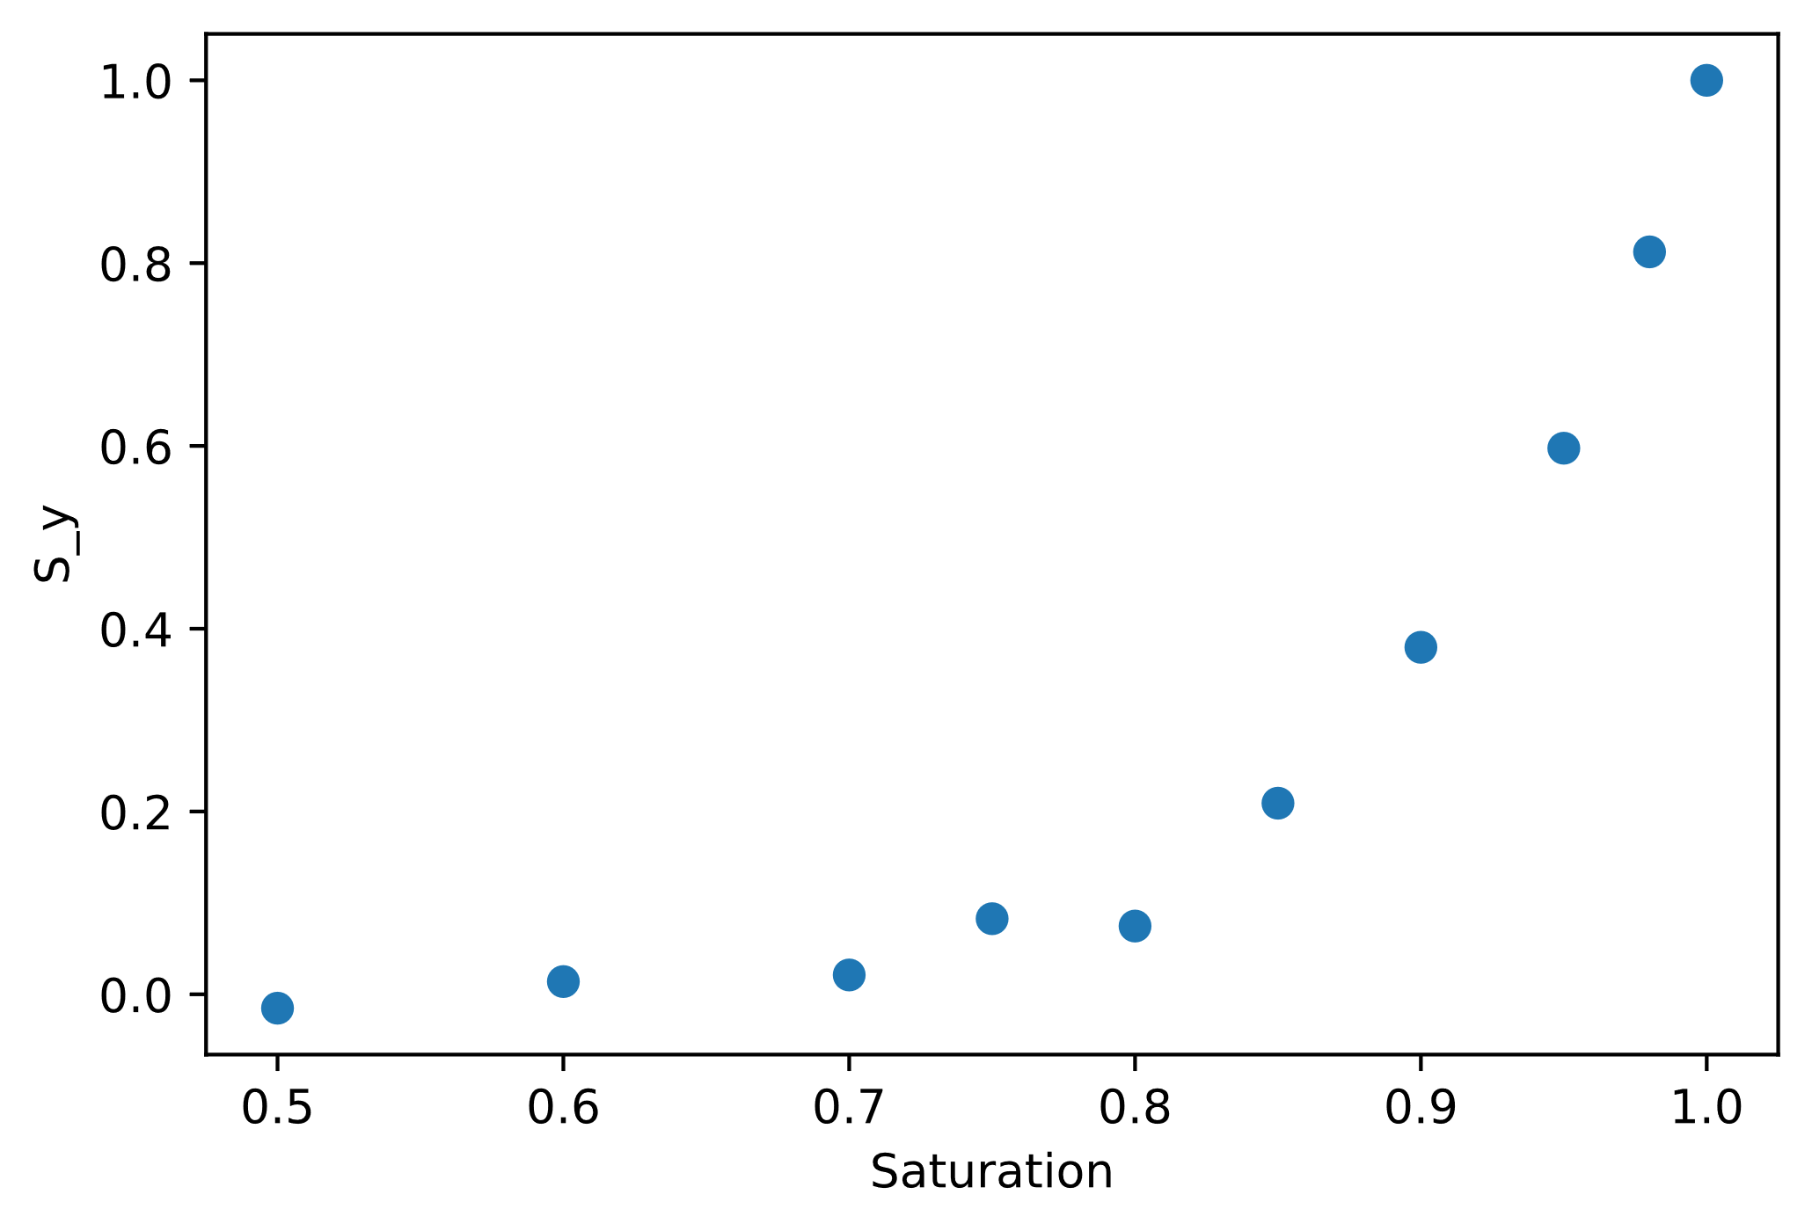

Slide 12
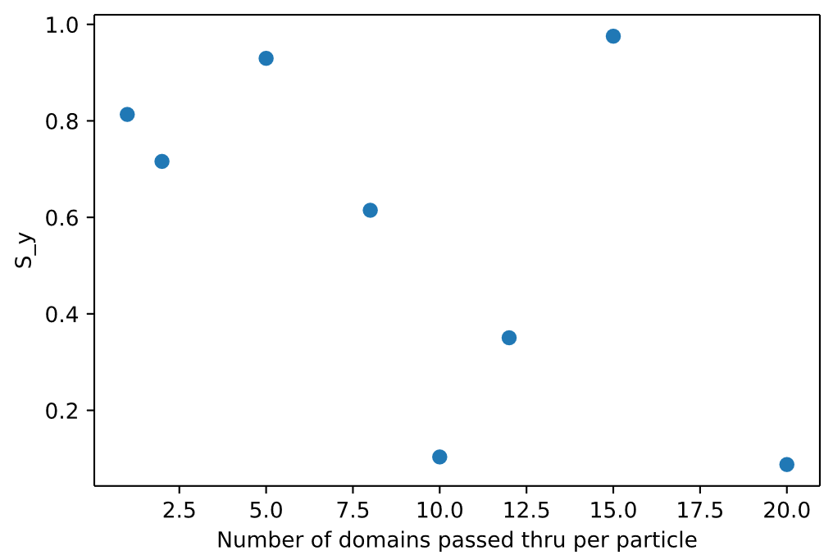
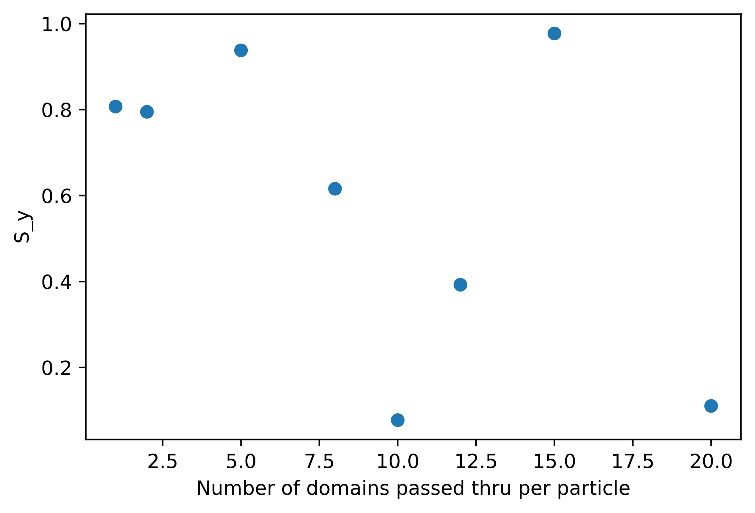
Number of domains passed thru per particle = [1, 2, 5, 8, 10, 12, 15, 20]

Slide 13
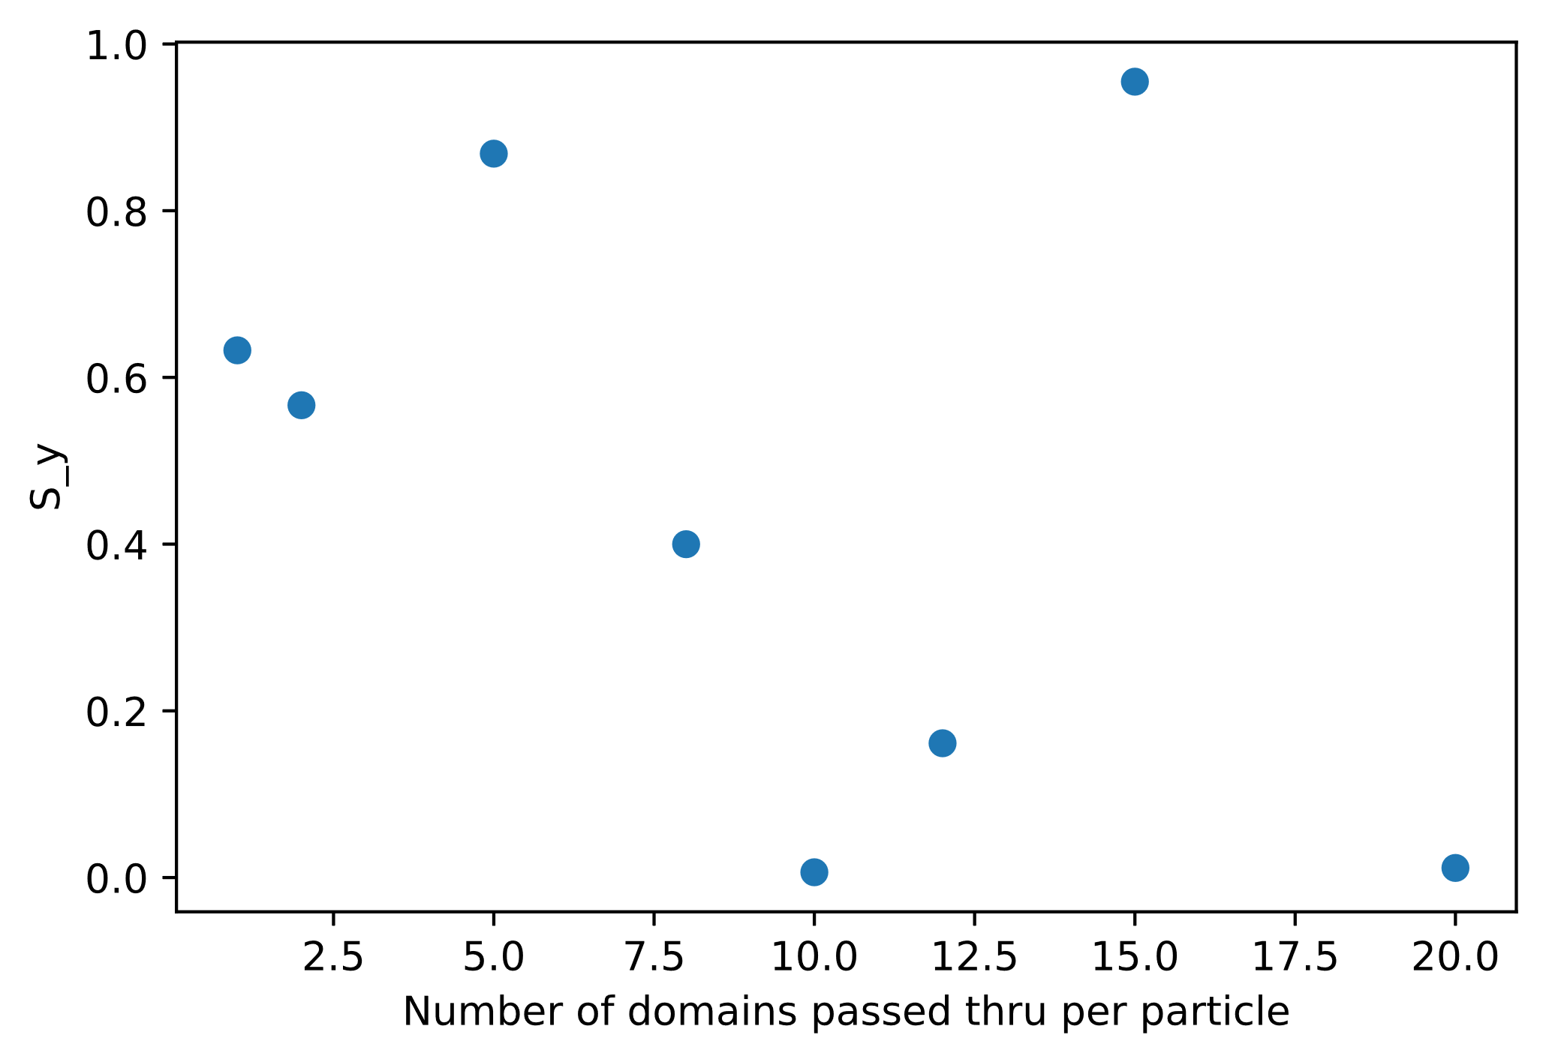

Slide 14
